Slide 1
Object Classification in Road Images
By Rory Egan
Supervised by J.J. Collins

Slide 2
Project Summary
The aim of this project is to use Neural Networks to classify multiple objects within road images
Will use a dataset of images from self-driving cars
Will utilise a CNN to classify objects

Slide 3
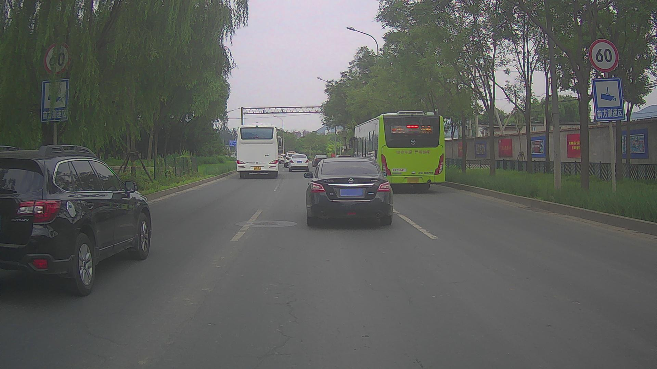
Project Environment
Machine Learning – tensorflow (python)
Computer Vision – OpenCV (python)
Dataset leveraged will be from Baidu Apollo range
Contains 10,000 training and 10,000 testing images

Slide 4
Classification vs Detection
Common use case for Neural Networks is image classification
Typical Classification problem – label dominant object
Object detection is slightly different
Detection = Classification + Localisation
Classification = what, Detection = where

Slide 5
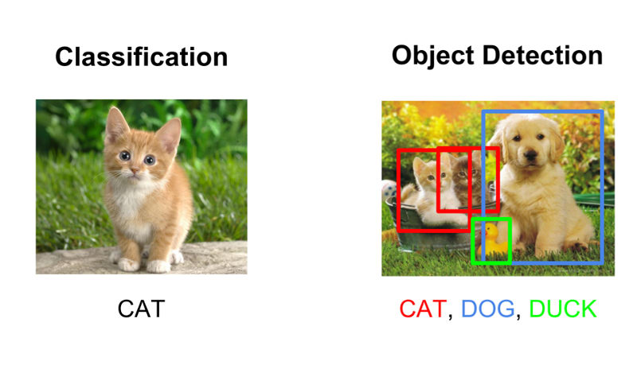

Slide 6
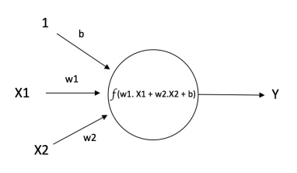
Neural Networks
First proposed in the 1940’s
Modelled after pathways present in the brain
Input is given to perceptron, activation function applied and output calculated

Slide 7
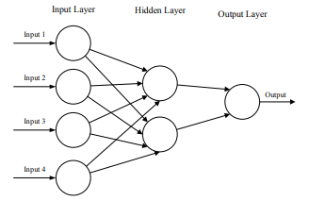
“Standard” Neural Network
Utilises backpropagation algorithm to learn
Weights are randomly assigned
Output is compared against known value and error is checked for each neuron – propagated back through the network

Slide 8
Image Related Issues
Suitable for smaller image processing – each pixel an input
Input image of 28x28 will produce 784 weights for each neuron in the first layer – will get too large quickly
Overfitting implications

Slide 9
Convolutional Neural Networks
LeNet architecture created in 1994 after many iterations since 1989 – one of the first examples of a CNN
In 2012 AlexNet was created – blew away competitors at ImageNet competition
CNN’s differ from MLP in that they have extra layers of Convolution and Pooling
Impractical to connect every neuron to every other neuron in previous layer – instead neuron connects to a local region of the input

Slide 10
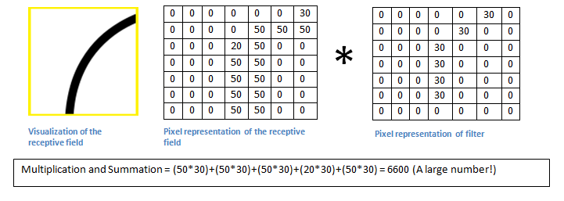
Convolution
Computer sees image as array of pixel values – 32 x 32 x 3
Convolution Layer – shines a filter/kernel over a receptive field – multiplies the value of the filter with the receptive field
After sliding over all features in the image we are left with a feature map of certain features within the image

Slide 11
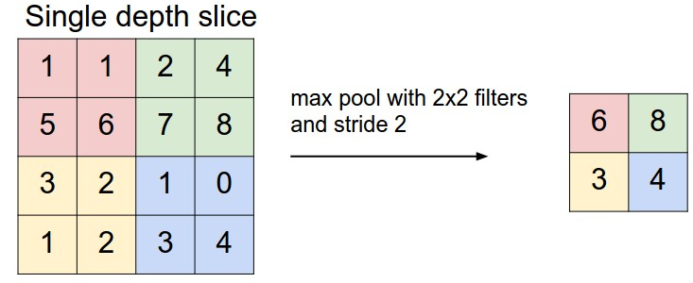
Pooling
Min, Max, Mean pooling
Place a matrix over the feature map and picking largest value in each pass
These values form the pooled feature map
Reduces image size while maintaining important elements – will help overfitting by eliminating less prominent features

Slide 12
Fully Connected Layer
Will compute the class scores, resulting in an output of 1x1xn where n is the number of possible classes
Each neuron in this layer is connected to all the neurons in the previous layer
Error is determined and backpropagation applied until network is correct
These techniques mean that CNN’s are able to train much faster and exhibit less overfitting – less layers required
Comparable results to “standard” Neural Network

Slide 13
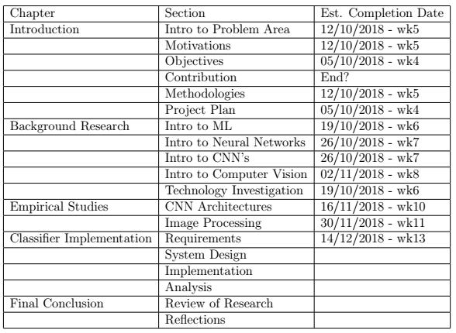
Work Done to Date
15 Key Papers Identified
6 Papers read
FYP report started in LaTex
Dataset identified
Free Coursera Machine Learning course started – Andrew Ng

